Slide 1

Transfer-matrix abstraction to analyze the effect of manufacturing variations in silicon photonic circuit
Team member: Carlos Gonzalez
Faculty Advisors: Priyank Kalla & Angela RAsmussen

Slide 2
motivation
The emergence of Silicon (Si) photonics necessitates the development of automated testing and validation techniques/tools.
Photonics have widespread applications in fields such as communication, signal processing, quantum, and reversible computation

Slide 3
Background Info
Silicon waveguides are transparent to telecommunication wavelength range enabling them to guide the transmission of a wave in the medium.
Silicon and silicon dioxide are ideal for constructing optical waveguides given the large refractive index contrast between the two, we focus on transmission at 1550nm.
We can represent optical systems with transfer matrices.

Slide 4
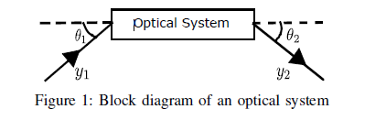
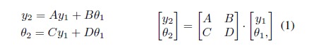
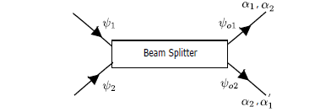
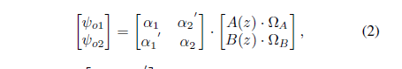
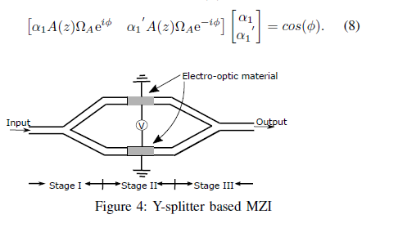
Optical systems & Transfer Matrices

Slide 5
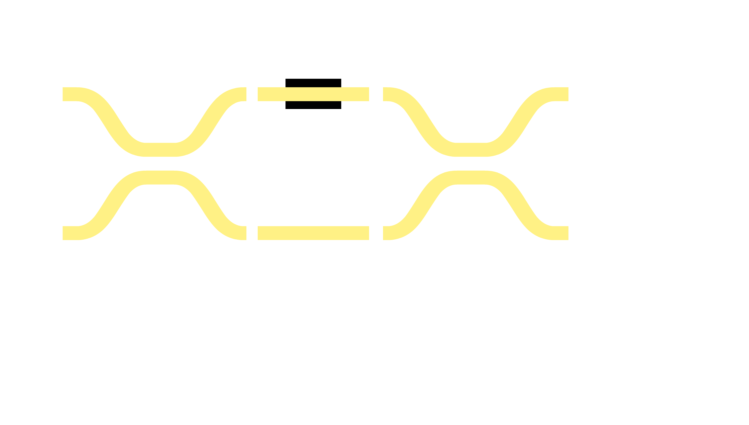




Mach-Zehnder Interferometer (MZI)
S = 0 → Δφ = π → bar
S = 1 → Δφ = 0 → cross

Slide 6
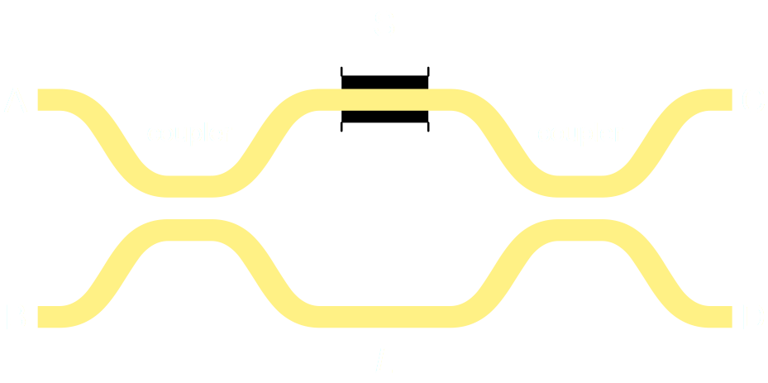
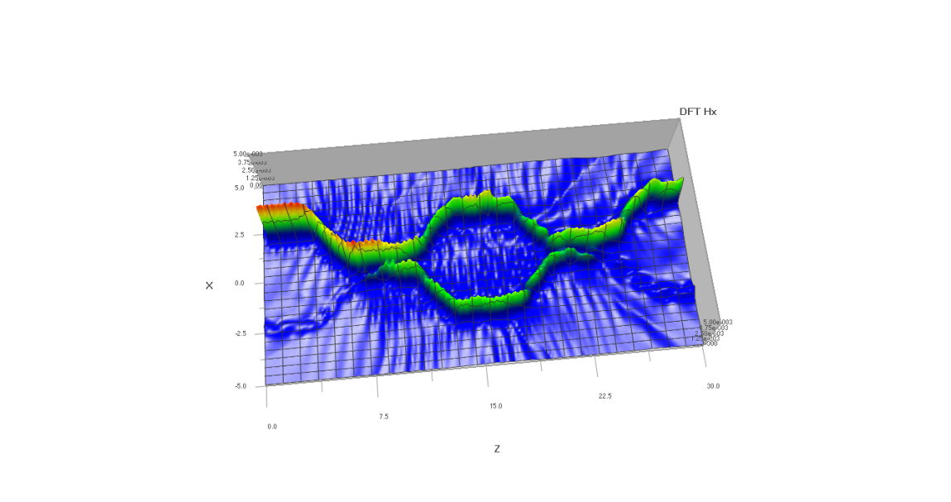
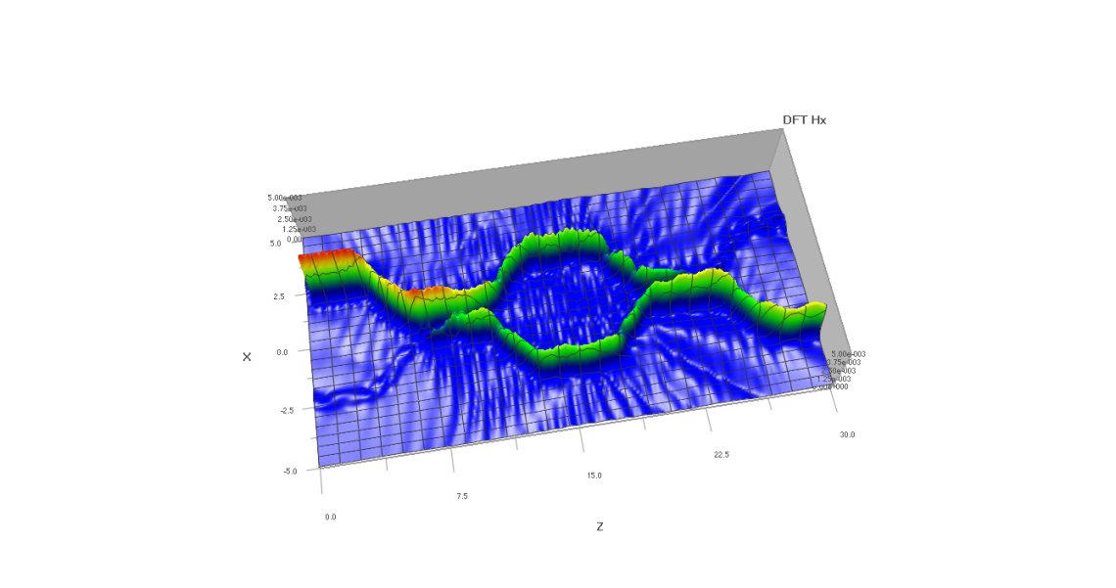
Crossbar Gates – Logic Building Block
Electrically controlled 2x2 Optical Router (“switch”)
s = electrical primary input
a, b, c, d = optical waveguides
Crossbar Gate
S = 0 (bar) → (a = c, b = d)
S = 1 (cross) → (a = d, b = c)

Slide 7
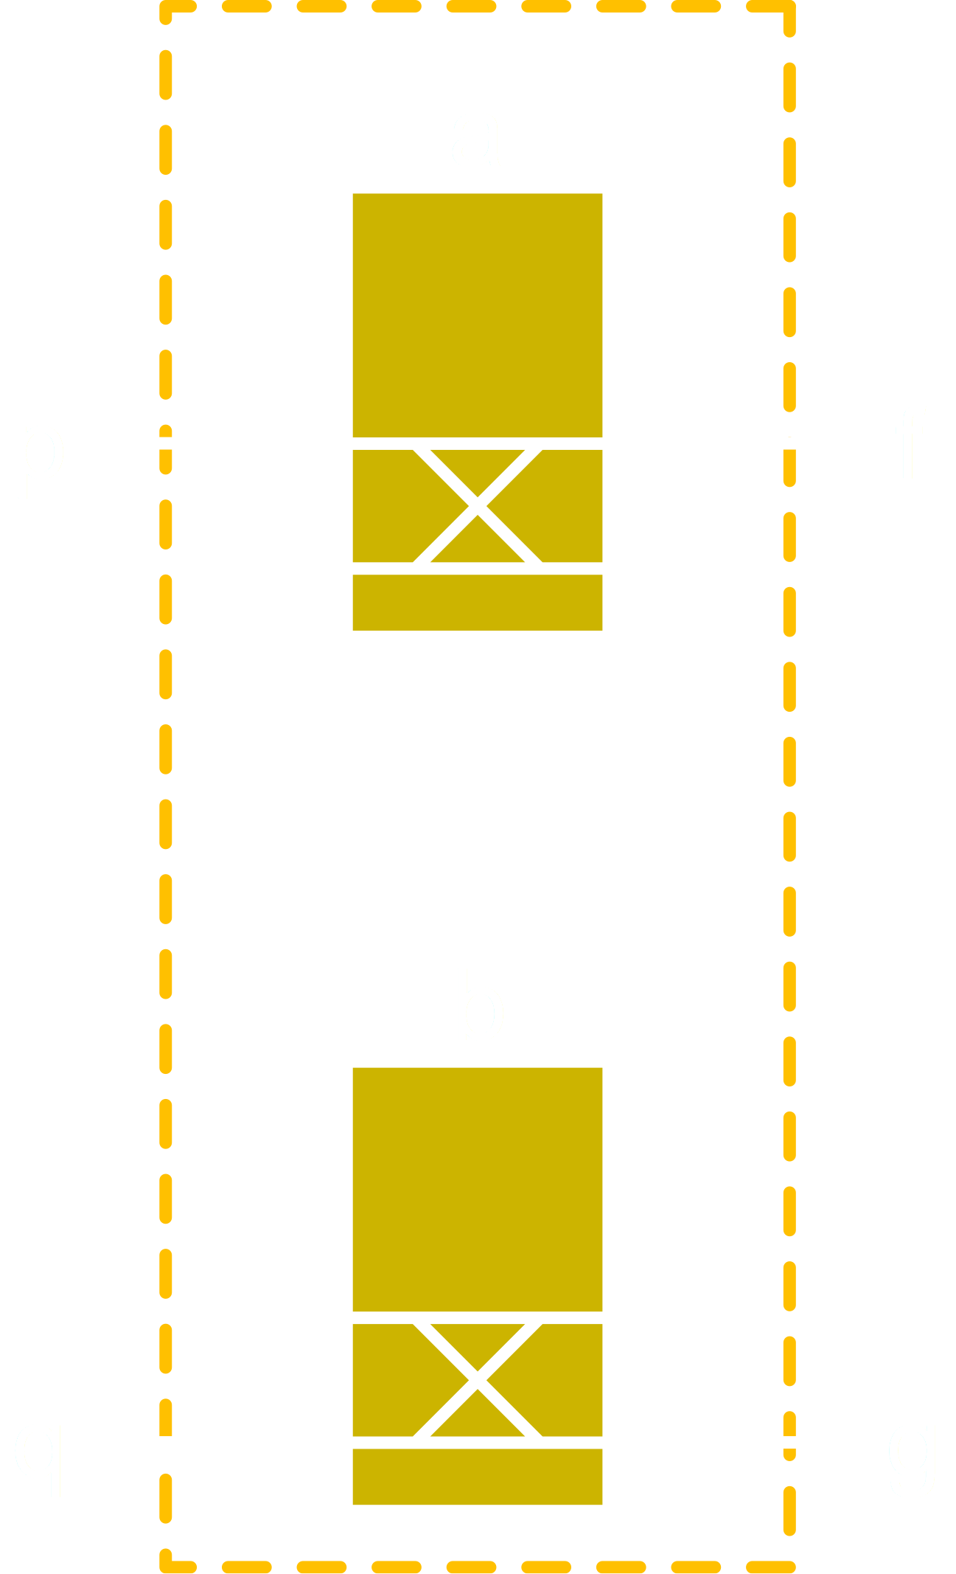
Virtual Gates

Slide 8


Virtual Gate Operators
AND
OR
XOR

Slide 9
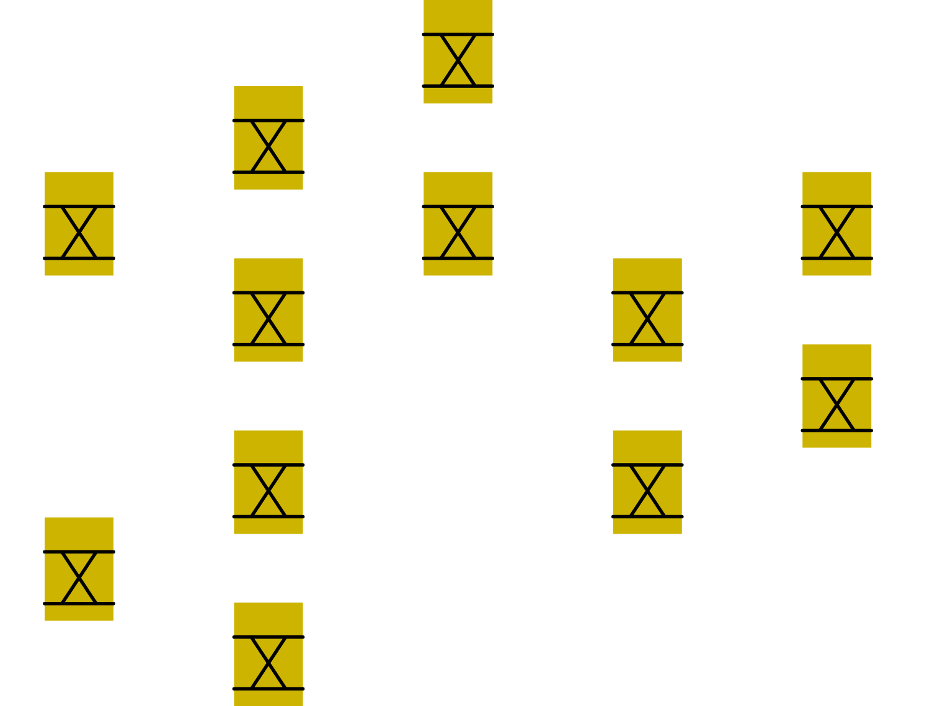
Multi-level Logic Decomposition

Slide 10
My intended Thesis work goals
Create a program that can use these virtual gates as “building blocks” to build circuits.
Create a file format to store and read optical circuits.
Create debug tools and channel routing tools.

Slide 11
Current work
I am currently working on building the classes for each optical system. Once I have all the needed classes, I will start creating the main program that reads in a circuit file.
Currently Trying to replicate a Ph.D. student’s simple simulation with my implementation.

Slide 12
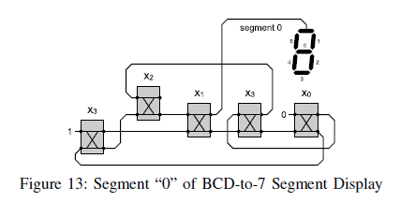
1st Experiment
Recreate this circuit design in my python program.

Slide 13
Thank you

Slide 14
Selected Publications
C. Condrat, P. Kalla, S. Blair, “Logic Synthesis for Integrated Optics”, Great Lakes Symposium on VLSI, 2011.
C. Condrat, P. Kalla, S. Blair, “Design Automation For silicon Nanophotonic integration”, D2t symposium Seminar, 2019

